Slide 1
Direction of Conformity Assesssment in ASEAN
Bussaba Saelim
ACCSQ /WG2 Co-Chair
Notes:
Good morning Ladies and Gentlemen, let me start by saying a few words about my background I’m Bussaba Saelim Head of CB Accreditation Group from National Standardization council of Thailand or NSC . My other function is the Co-Chair of WG on CA of the ASEAN Consultative Committee on Standard and Quality. So that I am delighted to present on the topic Direction of conformity assessment in ASEAN.
Before go to the topic I would like to express my sincere thanks and appreciation to the Srilanka Accreditation Body for its warm welcome and impeccable arrangements as the Host of APLAC PAC Annual meeting 2015. and for organized this host seminar.

Slide 2
Outline
What & Why ASEAN
AEC 2015 Milestone
CA in ASEAN
Notes:
I’ve divided my presentation into 3 parts: Firstly I’ll show you about What is ASEAN and Why to be ASEAN community. Secondly , we will look at the ASEAN milestone in this year 2015 to become AEC , ASEAN Economic Community. Thirdly I will talk about the work of WG 2 the WG on conformity assessment . The structure , scope of activities and the future direction after 2015. Which reflect the direction of Conformity Assesssment in ASEAN after 2015
I shall only take 17 minutes of your time and there will be time for question about 3 minutes.

Slide 3
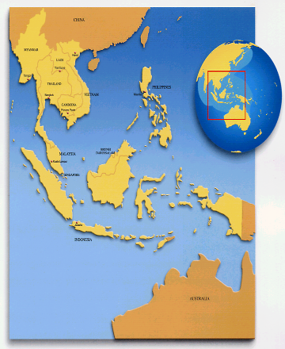
ASEAN: Association of South East Asian Nations
10 MEMBER STATES
Brunei Darussalam (7 January 1984)
Cambodia (30 April 1999)
Indonesia (8 August 1967)
Lao PDR (23 July 1997)
Malaysia (8 August 1967)
Myanmar (23 July 1997)
Philippines (8 August 1967)
Singapore (8 August 1967)
Thailand (8 August 1967)
Viet Nam (28 July 1995)
Notes:
For those who is not familiar with ASEAN , ASEAN stands for Association of South East Asian Nation. Now there are 10 member .
The founding economy is Thailand Phillipines Indonesia Malaysia Singapore
Brunei
Vietnam
Lao & Myanmar
And then Cambodia is the last economy joined in 1999.

Slide 4
GDP:
USD 2.4 trillion
A huge market: 625 million+ people
FDI USD 122 billion+
If ASEAN were a single country, it would already be the seventh-largest economy in the world, with a combined GDP of $2.4 trillion in 2013.
It is projected to rank as the fourth-largest economy by 2050.
McKinsey & Co – May 2014
Notes:
Population: 616,613,651 (2012)
Land area: 4,435,618 sq. km.
GDP: US$ 2.395 trillion (2014) and GDP per capita USD 3,832
Trade: US$ 2.51 trillion (2014) -- Exports = USD 1,271,128 Million; Imports = USD 1,240,388 Million
Foreign Direct Investment (FDI): US$ 122.4 billion (2013)
Latest statistics revealed that in general, ASEAN economies remained buoyant as nominal Gross Domestic Product (GDP) grew by 5.2 percent at US$ 2.4 trillion in 2013 from 2.3 trillion in the previous year. The continued economic growth is partly reflected in the improved GDP per capita at US$ 3,834 from US$ 3,781 in 2012.
On the other hand, ASEAN’s real GDP growth in 2013 was slightly lower by 0.7 percentage point at 5.2 percent compared to 2012. ASEAN5’s (Indonesia, Malaysia, Philippines, Singapore and Thailand) combined growth was recorded at 4.1 percent during the third quarter of 2014 from 5.1 percent during the same period in 2013, partly driven by adverse economic developments in Brunei Darussalam and Thailand.
Source : ASEAN Stats

Slide 5
Why an ASEAN Community?
Need to intensify political cooperation, strengthen peace and security in Southeast Asia
Enhance economic competitiveness of individual Member States, and of ASEAN as regional market and production base for global economic competition
Need to narrow the development gaps
Need to respond effectively to transnational threats to human security and new challenges in the 21st century
Harness human resources and benefit from rich cultural diversity in the ASEAN region
Gain international recognition and support for community-building

Slide 6
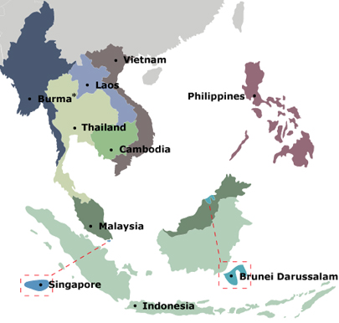
The ASEAN Journey to Community Building
2015
ASEAN Community
2007
Cebu Declaration
2003
Bali Concord II - APSC AEC ASCC
1997
ASEAN Vision 2020
a concert of Southeast Asian nations, outward looking, living in peace, stability and prosperity, bonded together in partnership in dynamic development and in a community of caring societies
1967
Bangkok Declaration
Notes:
ASEAN Summit in 2003, Bali Concord , the ASEAN Leaders resolved that an ASEAN Community shall be established comprising 3 pillars political and security community, economic community, and socio-cultural community
Cebu Declaration on the Acceleration of the Establishment of an ASEAN Community by 2015
As we all know ASEAN is now in the process of building an ASEAN Economic Community (AEC), which would be an integrated market and production base that is highly competitive, equitable, and fully integrated into the global economy.

Slide 7
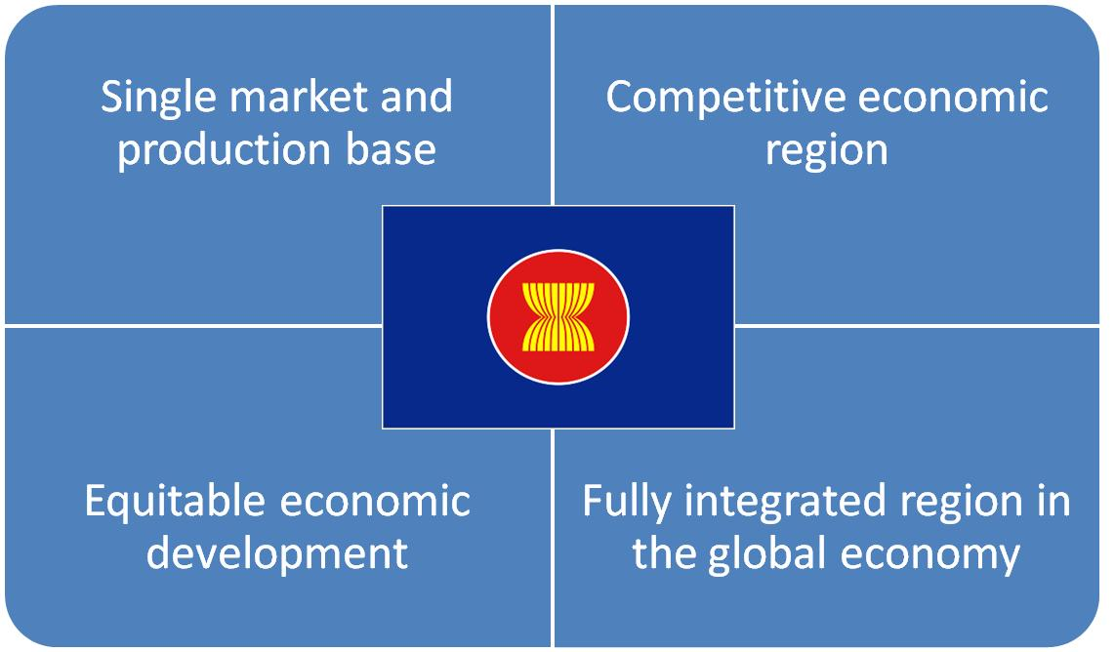
The AEC Building Milestones
Establish ASEAN as:

Slide 8
ASEAN Economic Ministers (AEM)
Senior Economic Official Meeting (SEOM)
ASEAN Consultative Committee for Standards and Quality (ACCSQ)
WG 1
Standards
and MRAs
WG 2
Conformity Assessment
WG 3
Legal
Metrology
JSC EEE
Joint Sectoral Committee for electrical and electronic equipment
ACC
ASEAN Cosmetic Committee
PPWG
Pharma-
ceutical Product Working Group
PFPWG
Prepared Foodstuff Product Working Group
APWG
Automotive Product Working Group
RBPWG
Rubber-based Product Working Group
WBPWG
Wood-based Product Working Group
MDPWG
Medical Device Product Working Group
TMHSPWG
Traditional Medicine & Health Supplement Product Working Group
Notes:
ACCSQ was formed by the ASEAN Economic Ministers in 1992 to support the objectives of the ASEAN Free Trade Area (AFTA).

Slide 9
Roles
ASEAN Summit
AEC
SEOM
Trade Facilitation
ACCSQ
SCA Tech. Infra.
WG 2
Conformity Assessment Infrastructure

Slide 10
ASEAN Standards & Conformance Framework
1. Ensure Quality, Safety, Health and Environment
2. Facilitate Trade and Market Access
Technical Regulations
Technical Regulations
Standards
Harmonised
Regulatory
Regime
Standards
Conformity Assessment Systems
Conformity Assessment Systems
MRAs
National Metrology System
National Metrology System
Recognition amongst ASEAN Member States
Notes:
ASEAN through the ACCSQ has endeavoured to harmonize the national standard with international std and implement MRA on CA to achieve it’s end goal “one Std one test accepted everywhere” the priority for harmonization will be given to the std used in technical regulation in MS.

Slide 11
ASEAN CA technical Infrastructure
AB
(ISO/IEC 17011)
Government
recognition
International recognition
competence
CAB
(LAB : ISO/IEC 17025
IB : ISO/IEC 17020
CB : ISO/IEC 17021 G.65)
Sectoral Regulation
compliance
Organization/Products/Object of CA
(ISO/IEC 17050 -1,2)
confidence
confidence
Government
Stakeholders

Slide 12
MS | AB | Recognition
Brunei | -
Cambodia | (NAFP)
Indonesia | KAN | ILAC, IAF
Laos PDR | (NAFP)
Malaysia | Standards of Malaysia | ILAC, IAF
Myanmar | -
Phillipines | PAO | ILAC, IAF
Singapore | SAC | ILAC, IAF
Thailand | NSC | ILAC, IAF
Vietnam | BOA | ILAC, IAF

Slide 13
WG2 :Scope of Activities
Chair : Malaysia Co-Chair : Thailand
1. To formulate policies for accreditation and CA for adoption at the regional level.
2. To provide guidance to the sectoral bodies.
3. Enhancing the capability of ABs
4. Enhancing the competence of CABs
5. Strengthening the implementation of ILAC, IAF, APLAC and PAC MRAs /MLAs
6. Promoting recognition and acceptance
7. Consolidating ASEAN’s voice into regional and international organization of accreditation bodies.

Slide 14
ACCSQ WG 2 Post 2015
Promoting recognition and acceptance of CA results amongst ASEAN regulatory bodies including through the PWGs
Raise awareness for ASEAN RB
Collaboration between PWGs & WG2
Co-operation among NAB to facilitate MRAs
Enhancing the competence of ABs and CABs in AMS
Develop ABs in CLM+B
Notes:
1
Promoting recognition and acceptance of conformity assessment results amongst ASEAN regulatory bodies including through the PWGs
Raise awareness for ASEAN regulatory bodies;
Collaboration between PWGs and WG 2 to develop conformity assessment requirements;
Member States shall establish co-operation among National Accreditation Bodies in ASEAN to facilitate the implementation of MRAs in regulated and non-regulated sectors
2
Enhancing the competence of ABs and CABs in AMS
2.1 Enhancing competence of ABs;
2.2 Enhancing competence of CABs.
3
Develop ABs in CLM+B
To establish act for establishment of ABs;
To enhance the competence of NAFP;
To achieve regional/international recognition;
Continuance of NAFP as a tool for the development of ABs

Slide 15
Conclusion

Slide 16
Thank You
"One Vision, One Identity, One Community"

